Slide 1



SQL Server Encryption
Ben Miller
ben@benmiller.net
Twitter: @DBAduck
Blog: http://dbaduck.com
http://PowerShellDBA.com

Slide 2
Introduction
Using SQL Server since version 4.2
SQL Server MCM
SQL Server MVP
Been in IT for over 25 years
Automation and Integration are specialties
MCAD: C# and Web Development
MCSE: Data Platform

Slide 3
Agenda
Encryption Hierarchy
Keys
Symmetric Keys
Asymmetric Keys
Database Encryption Key
Certificates
TDE
Encrypted Backup
Cell Encryption

Slide 4
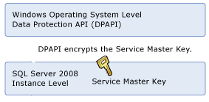



Encryption Hierarchy

Slide 5
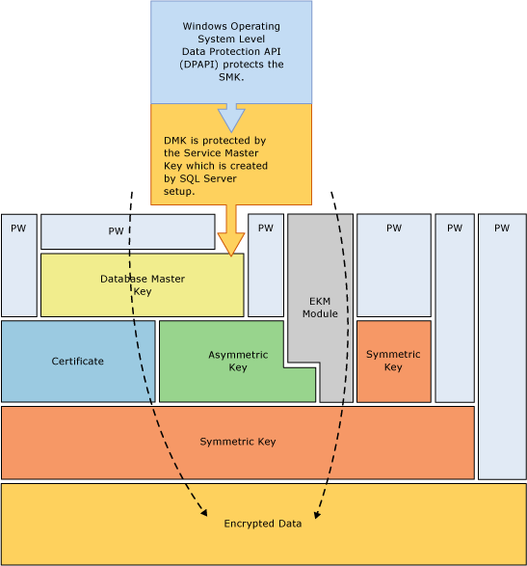

Slide 6
Encryption Keys
Symmetric Keys
Do not use RC4 and RC4_128 algorithms
Symmetric keys created with ALGORITHM = TRIPLE_DES_3KEY use TRIPLE DES with a 192-bit key.
Symmetric keys created with ALGORITHM = TRIPLE_DES use TRIPLE DES with a 128-bit key.
Assymmetric Keys
Only Windows logins, SQL Server logins, and application roles can own asymmetric keys. Groups and roles cannot own asymmetric keys
This is a Key Pair and Encrypted by Master Key or Password or EKM Provider
Can be RSA_512, RSA_1024, RSA_2048

Slide 7
Encryption Keys (2)
Database Encryption Key
Special Symmetric key used in TDE
Notes:
You should SALT the values on encryption so that comparisons or replacement hacks cannot take place.
For best performance, encrypt data using symmetric keys instead of certificates or asymmetric keys
Database master keys are protected by the Service Master Key
An Extensible Key Management (EKM) module holds symmetric or asymmetric keys outside of SQL Server
The Service Master Key and all Database Master Keys are symmetric keys

Slide 8
What is TDE?
Transparent Data Encryption
Encrypted Database “At Rest”
Encryption with AES or 3DES algorithms
AES_128, AES_192, AES_256, TRIPLE_DES_3KEY
Encryption is performed at the Page Level
Data and Log files
When one database is encrypted, tempdb is encrypted by default.
FILESTREAM data is not encrypted when TDE is enabled

Slide 9
Requirements for TDE - Review
SQL Server 2008/2012/2014 Enterprise Edition
Master database – Master Key
Master database – Certificate
User database – Database Encryption Key
Stored in the boot record of database for recovery
ALTER DATABASE SET ENCRYPTION ON

Slide 10
Benefits of TDE
No schema changes like cell level encryption
Page Level encryption
MSFT estimates degradation at 3-5% instead of 20-28% with cell level encryption **
Secure backups by default
Invisible to the User
“At Rest” Encryption

Slide 11
Disadvantages of TDE
Backup Compression no longer effective
Enterprise Edition required
With Cell Level encryption you have finer control over encrypted elements
With one database encrypted, TempDB is encrypted for ALL databases
Even when all DBs are decrypted, Server Restart required to remove encryption from TempDB

Slide 12
Backup Encryption
Requirements
Certificate or Asymmetric Key in EKM Provider
New Media Set
Backup Compression still effective

Slide 13
Show me the money! Demo

Slide 14
System DMVs for Encryption
sys.key_encryptions
sys.symmetric_keys
sys.certificates
sys.dm_database_encryption_keys
sys.asymmetric_keys

Slide 15
Things to watch for…
BACKUP database before enabling TDE
You are allowed to drop a certificate in the hierarchy used for TDE **
BACKUP all Certificates and Private Keys
BACKUP all Keys for safe keeping
In Mirroring and Replication, both databases are encrypted
** Prior to SQL 2008 R2 SP2 you can drop the certificate because there is no dependency held.

Slide 16
Ticking Time Bombs
Certificates can be dropped (pre SQL 2008R2 SP2) even if TDE is enabled on a database.
Database will still function when certificate is dropped until restart. Ensure you have a backup.

Slide 17
Summary
Only available in Enterprise Edition
TDE is enabled via Keys and Certificates
Data is encrypted “At Rest” not over the wire
Backups of Encrypted database are encrypted
Protect your Encryption assets (Keys, Certificates, etc)

Slide 18
Resources
SQL PASS (http://www.sqlpass.org)
SQL Saturday in your area (sqlsaturday.com)
SQL Server User Groups in your area
Microsoft SQL Server website
http://www.microsoft.com/sql
SSWUG.org
http://www.sswug.org

Slide 19
Contact
Ben Miller
Email: ben@sqlsolutionsgroup.com
Twitter: @DBAduck
Blog: http://dbaduck.com
http://PowerShellDBA.com

